Slide 1
ACTEC
International Estate Planning Committee
November 4, 2022
San Francisco, CA
Practical advice addressed to US persons
for acquiring a property located in France
Maryse Naudin
Avocat au barreau de Paris
Tirard, Naudin
9 rue Boissy d’Anglas
75008 Paris
France
Tel: +33 1 53 57 36 00 Fax : +33 1 47 23 63 31
lawfirm@tirard-naudin.com

Slide 2
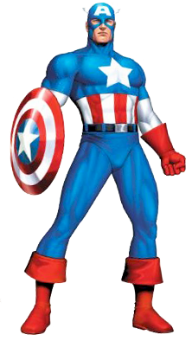


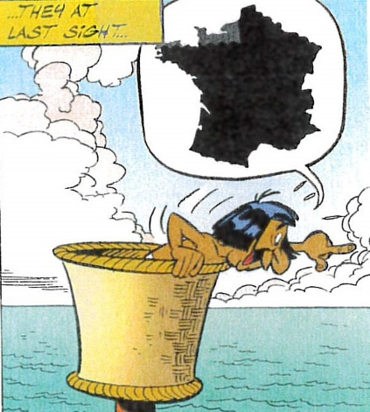
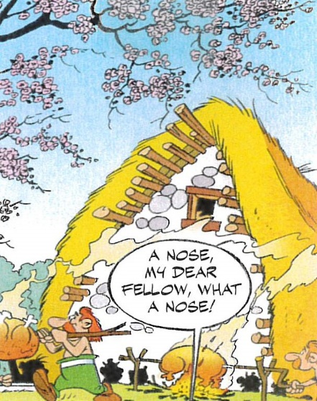

Case Study
(Inspired by Real Events)
Facts and Characters
(Based on Marvel and DC Comics and Asterix the Gaul Cartoons)
The US Purchaser and his wife
Captain America
Wonder Woman
The French Real Property
“Sweet Home”
Superman
The American Lawyer
(ACTEC Fellow)

Slide 3

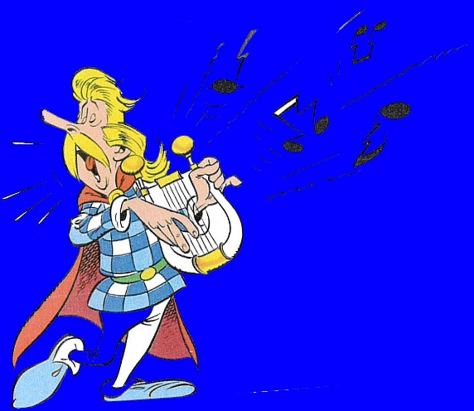

Case Study
“Sweet Home”
The French Seller and his wife
Harmonia
Cacofonix

Slide 4
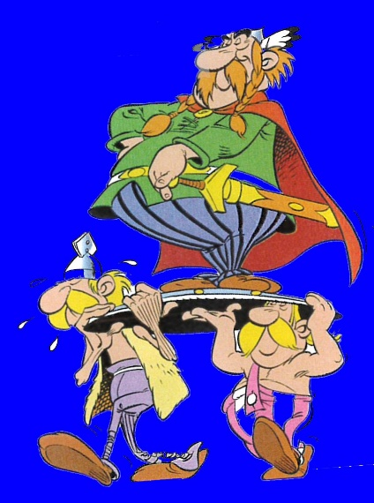
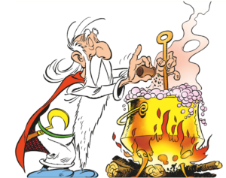
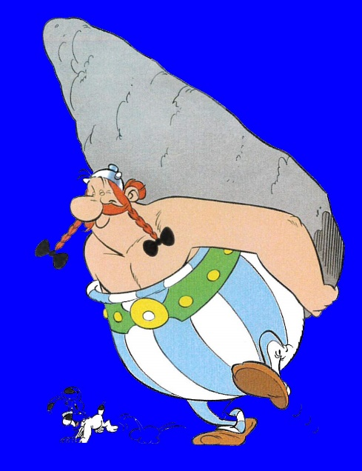
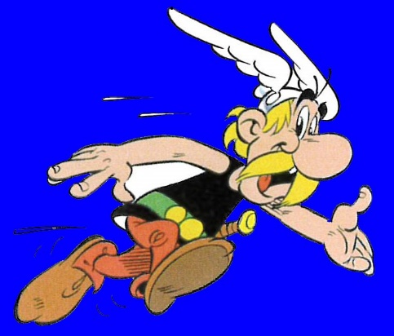
Case Study
Other Characters
Getafix
Vitalstatistix
The French Notaire introduced by Getafix
The Real Estate Broker
Obelix
Asterix
The Notaire introduced by Asterix
The French Avocat

Slide 5

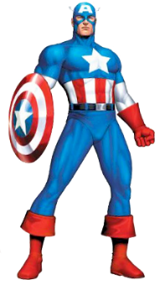
Workflow at the time of the Acquisition
1. The seller and the purchaser agree on the sale price, through the broker
I want to sell
I want to make a deal
I want to buy
2. Signature of the preliminary agreement (“compromis de vente”)
  The purchaser is deemed to know everything about the real estate property
  Condition precedents must be drafted with great care
  A substitution clause should be provided (to allow the insertion of at least one intermediary corporation between the ultimate purchaser (Captain America) and the property (Sweet home)
  Payment by the purchaser of a prepayment (“indemnité d’immobilisation”)
  When all condition precedents are met (as a general rule 2 months later)
  3. Signature of the notarized deed of acquisition
  Payment of the purchase price and transfer duties

Slide 6



At the time of the purchase
What to Avoid
I want to sell
As a French notaire, I am entitled to represent both parties
You should sign the French preliminary agreement as a matter of urgency
I want to buy

Slide 7

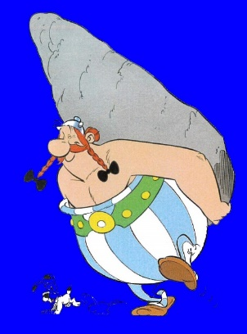





At the time of the signature of agreements (in French)
What we recommend
I speak English (French accent included)
I want to sell
Teamwork
between notaires
We want our client to be happy
We want our client to be happy
I want to buy
Teamwork between lawyers

Slide 8
Identifying the Best ownership structure of Sweet Home: When? Why?
The ownership structure should be determined and implemented between the date where Captain America decides to purchase Sweet Home and the date of the signature of the notarized deed of acquisition
There is no standard holding structure to acquire a real estate property located in France
It is necessary to identify on a case-by-case basis the most suitable holding structure according to the facts and circumstances of each acquisition
Factual elements concerning the buyer, his/her family and the French property should be taken into consideration by the purchaser’s French and US lawyers, working together

Slide 9
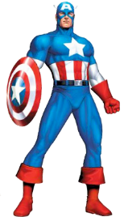

What possible structure may be used by Captain America?
US corporation
Foreign corporation
French corporation
US corporation
French corporation

Slide 10



What possible structure may be used by Captain America?
US corporation
Foreign corporation
French corporation
US corporation
French corporation

Slide 11


What possible structure may be used by Captain America?
Split ownership (“propriété”)
Between usufruct (“usufruit”) and bare ownership (“nue propriété”)
usufruct
Bare
ownership
usufruct
Bare
ownership
French corporation

Slide 12

Can Captain America use a trust to hold Sweet Home?
What to avoid
What we recommend
Trustee
Trustee
Trust
US Trust
Grantor
Beneficiaries
Corporation

Slide 13

How to identify the best ownership structure
Brainstorming and teamwork
From a US standpoint
Distinction between usufruct and bare ownership may entail adverse consequences
We should avoid probate
A trust would be helpful
Sweet Home will be used by my family members, transferred upon my death to my wife, then to our children. I wish to reduce my tax burden.
From a French standpoint
Using a US trust to avoid probate means interposing at least one intermediary corporation
Using an LLC entails adverse consequences
What about using an SCI?

Slide 14
Illustration of a possible solution
What to avoid
What we recommend
Trustee
Trustee
US
Trust (s)
US
Trust (s)
Beneficiaries
Grantor
Beneficiaries
Société civile immobilière (SCI)
LLC
Will governed by one of the States’ Law
Will governed by one of the States’ Law

Slide 15
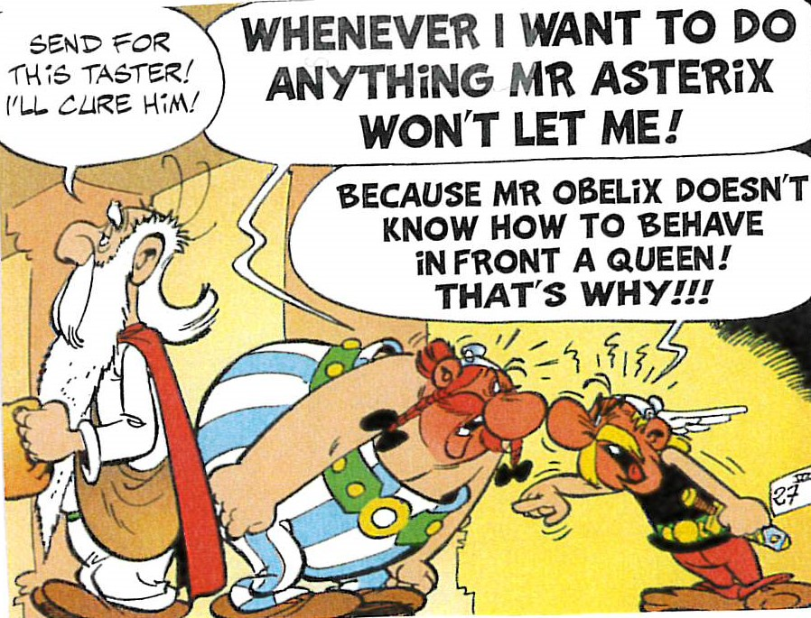
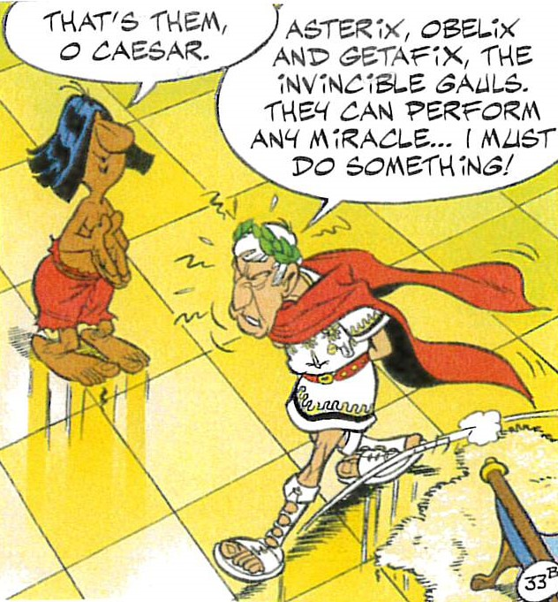
French tax treatment of the ownership of Sweet Home by Captain America
Captain America’s French Advisors “Brainstorming”
French Tax Authorities (FTA) devising a plan
?!!
OF THE FTA

Slide 16






Société à Prépondérance Immobilière (SPI)
“Real Estate Corporation”
US Corporation qualifies as an SPI
US Corporation does not qualify as an SPI
US Corporation
SPI
US Corporation
Foreign Corporation
SPI
Foreign Corporation
SPI
France
French Corporation
SPI
French Corporation
SPI
France
Market value of French movable assets 50
Market value of Sweet Home 100
Market value 100
Market value 120

Slide 17
Taxes due in France at the time of the purchase of Sweet Home
Sweet Home is purchased
  Transfer duties and notaire’s fees : approximately 8% of the purchase price of Sweet Home (depending on the value of the home and its location)
The shares of an existing corporation, French or foreign, are purchased
  Transfer duties: 5% of the purchase price of the shares
  Notaire is not necessary

Slide 18
Taxes due in France during the ownership of Sweet Home
Taxation of rental income
  Sweet Home is owned either directly by Captain America or through an SCI
    If Sweet Home is freely used by family members or friends: no taxation
    Individual income tax due if the property is rented out
      Individual income tax computed at progressive rates with a marginal rate of 45% + Social contributions: 17,20%
      marginal rate of taxation: 62,20 % with a minimum taxation of 30% (for US resident taxpayers)
  Sweet Home is owned by a corporation which does not qualify as a transparent entity
    Corporation tax is due if the property is rented out or on a notional income if the property is freely used by family members or friends
    Corporation tax computed at the flat rate of 25% on the profit realized by the corporation

Slide 19
Taxes due in France during the ownership of Sweet Home
Wealth tax on real property “impot sur la fortune immobilière” (IFI)
  Due on each January 1st on the market value of Sweet Home or of the shares of the corporation owned by Captain America
  When the market value of Sweet Home (or shares), reduced by deductible loans, exceeds a certain amount (€ 1,3 million for 2022)
  Progressive rates from 0.5 % to 1.5% (market value exceeding € 10 million for 2022)

Slide 20
Capital Gains tax due upon the sale of Sweet Home
Sweet Home is sold by Captain America or by the SCI held by Captain America or
the shares of the SCI are sold (regardless of the country of incorporation of the SCI)
  Individual income tax is due at the flat rate of 19%
  Social contributions are due at the flat rate of 17.2%
  A full exemption applies if Sweet Home is Captain America’s main residence
  Rebates apply depending on the duration of ownership : full exemption of income tax after 22 years of ownership and full exemption of social contributions after 30 years of ownership
Sweet Home is sold by an LLC subject to French corporation tax
  Corporation tax is due at the rate of 25% on the difference between the sale price and the net book value. No rebate applies nor exemption.

Slide 21
Inheritance Tax due upon Captain America’s Death
French gift or inheritance tax applies on the transfer for no consideration of Sweet Home
Between spouses
  Inheritance tax: full exemption without condition nor limit.
  Gift tax: progressive rates scale with a marginal rate of 45%.
Between parents and children
  Gift and inheritance tax: progressive rates scale with a marginal rate of 45%. A 100,000 € rebate every 15 years
  Between unrelated persons: 60%

Slide 22
Reporting Obligations due in France
On all intermediate corporations, entities and trusts qualifying as SPI (annual 3% tax)
On the trustee (trust’s annual returns and event-based returns)

Slide 23
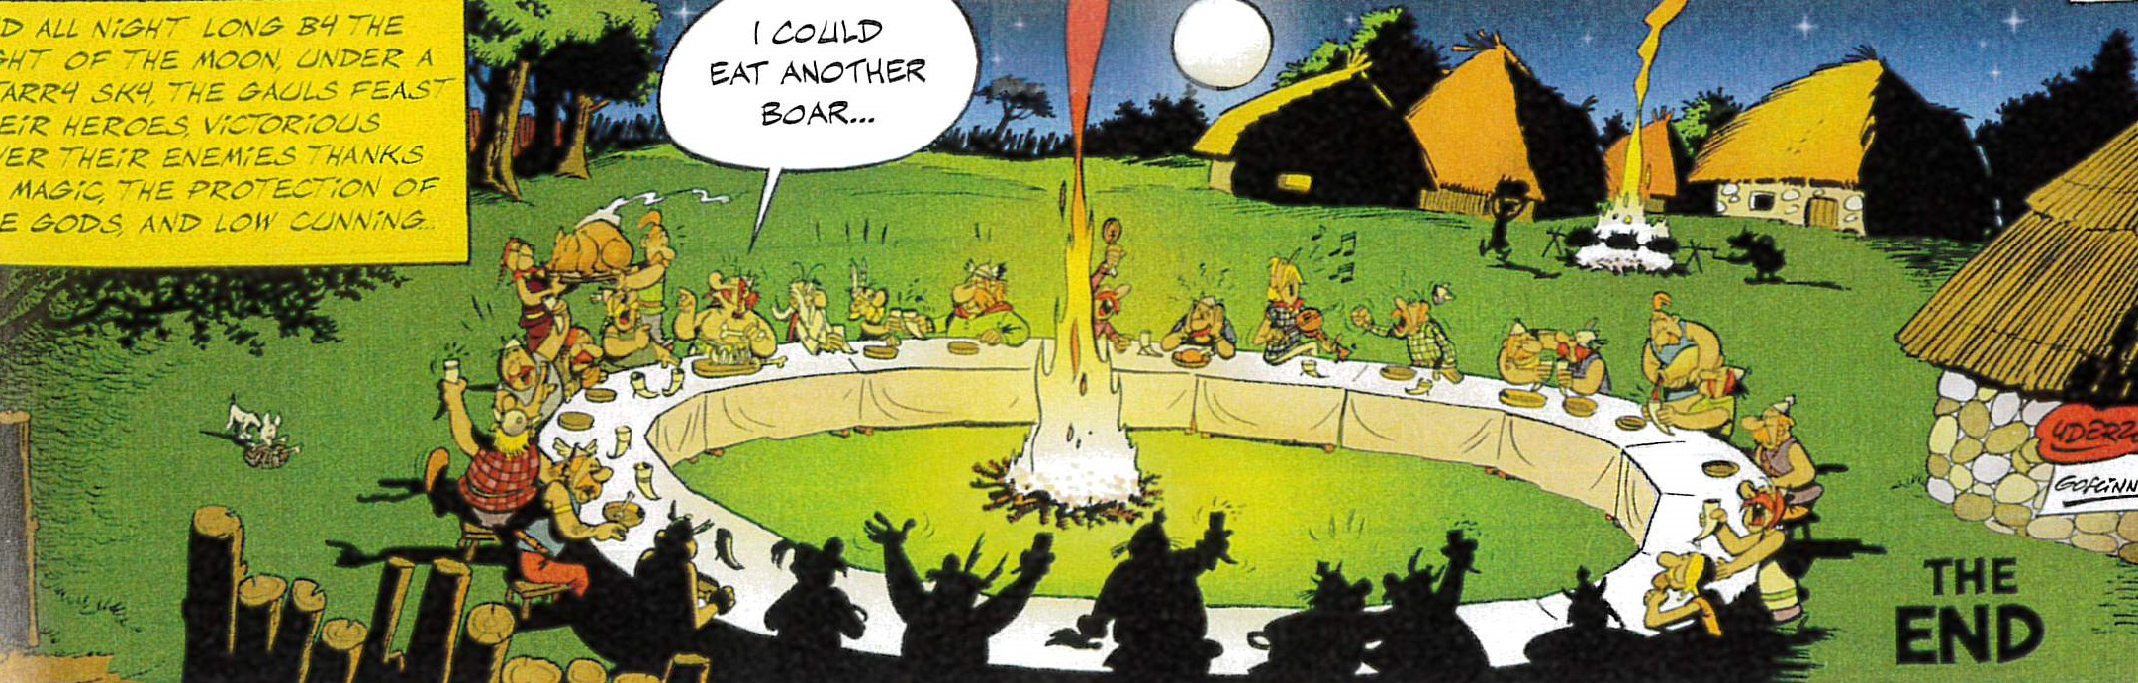



After the signature of the notarized deed of acquisition

